Slide 1

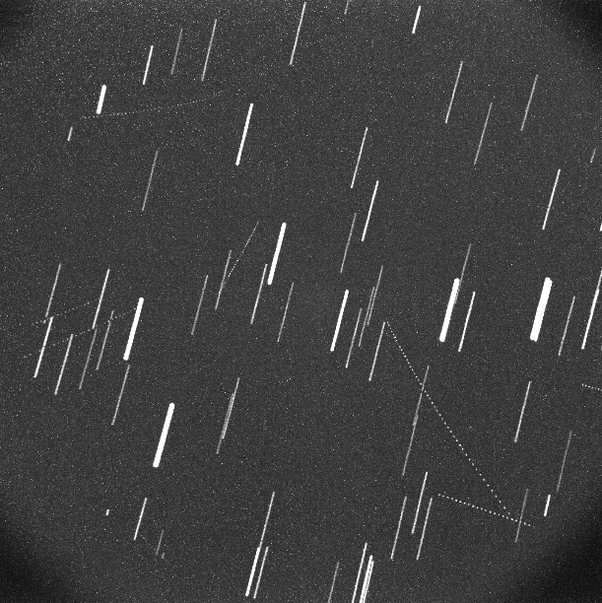
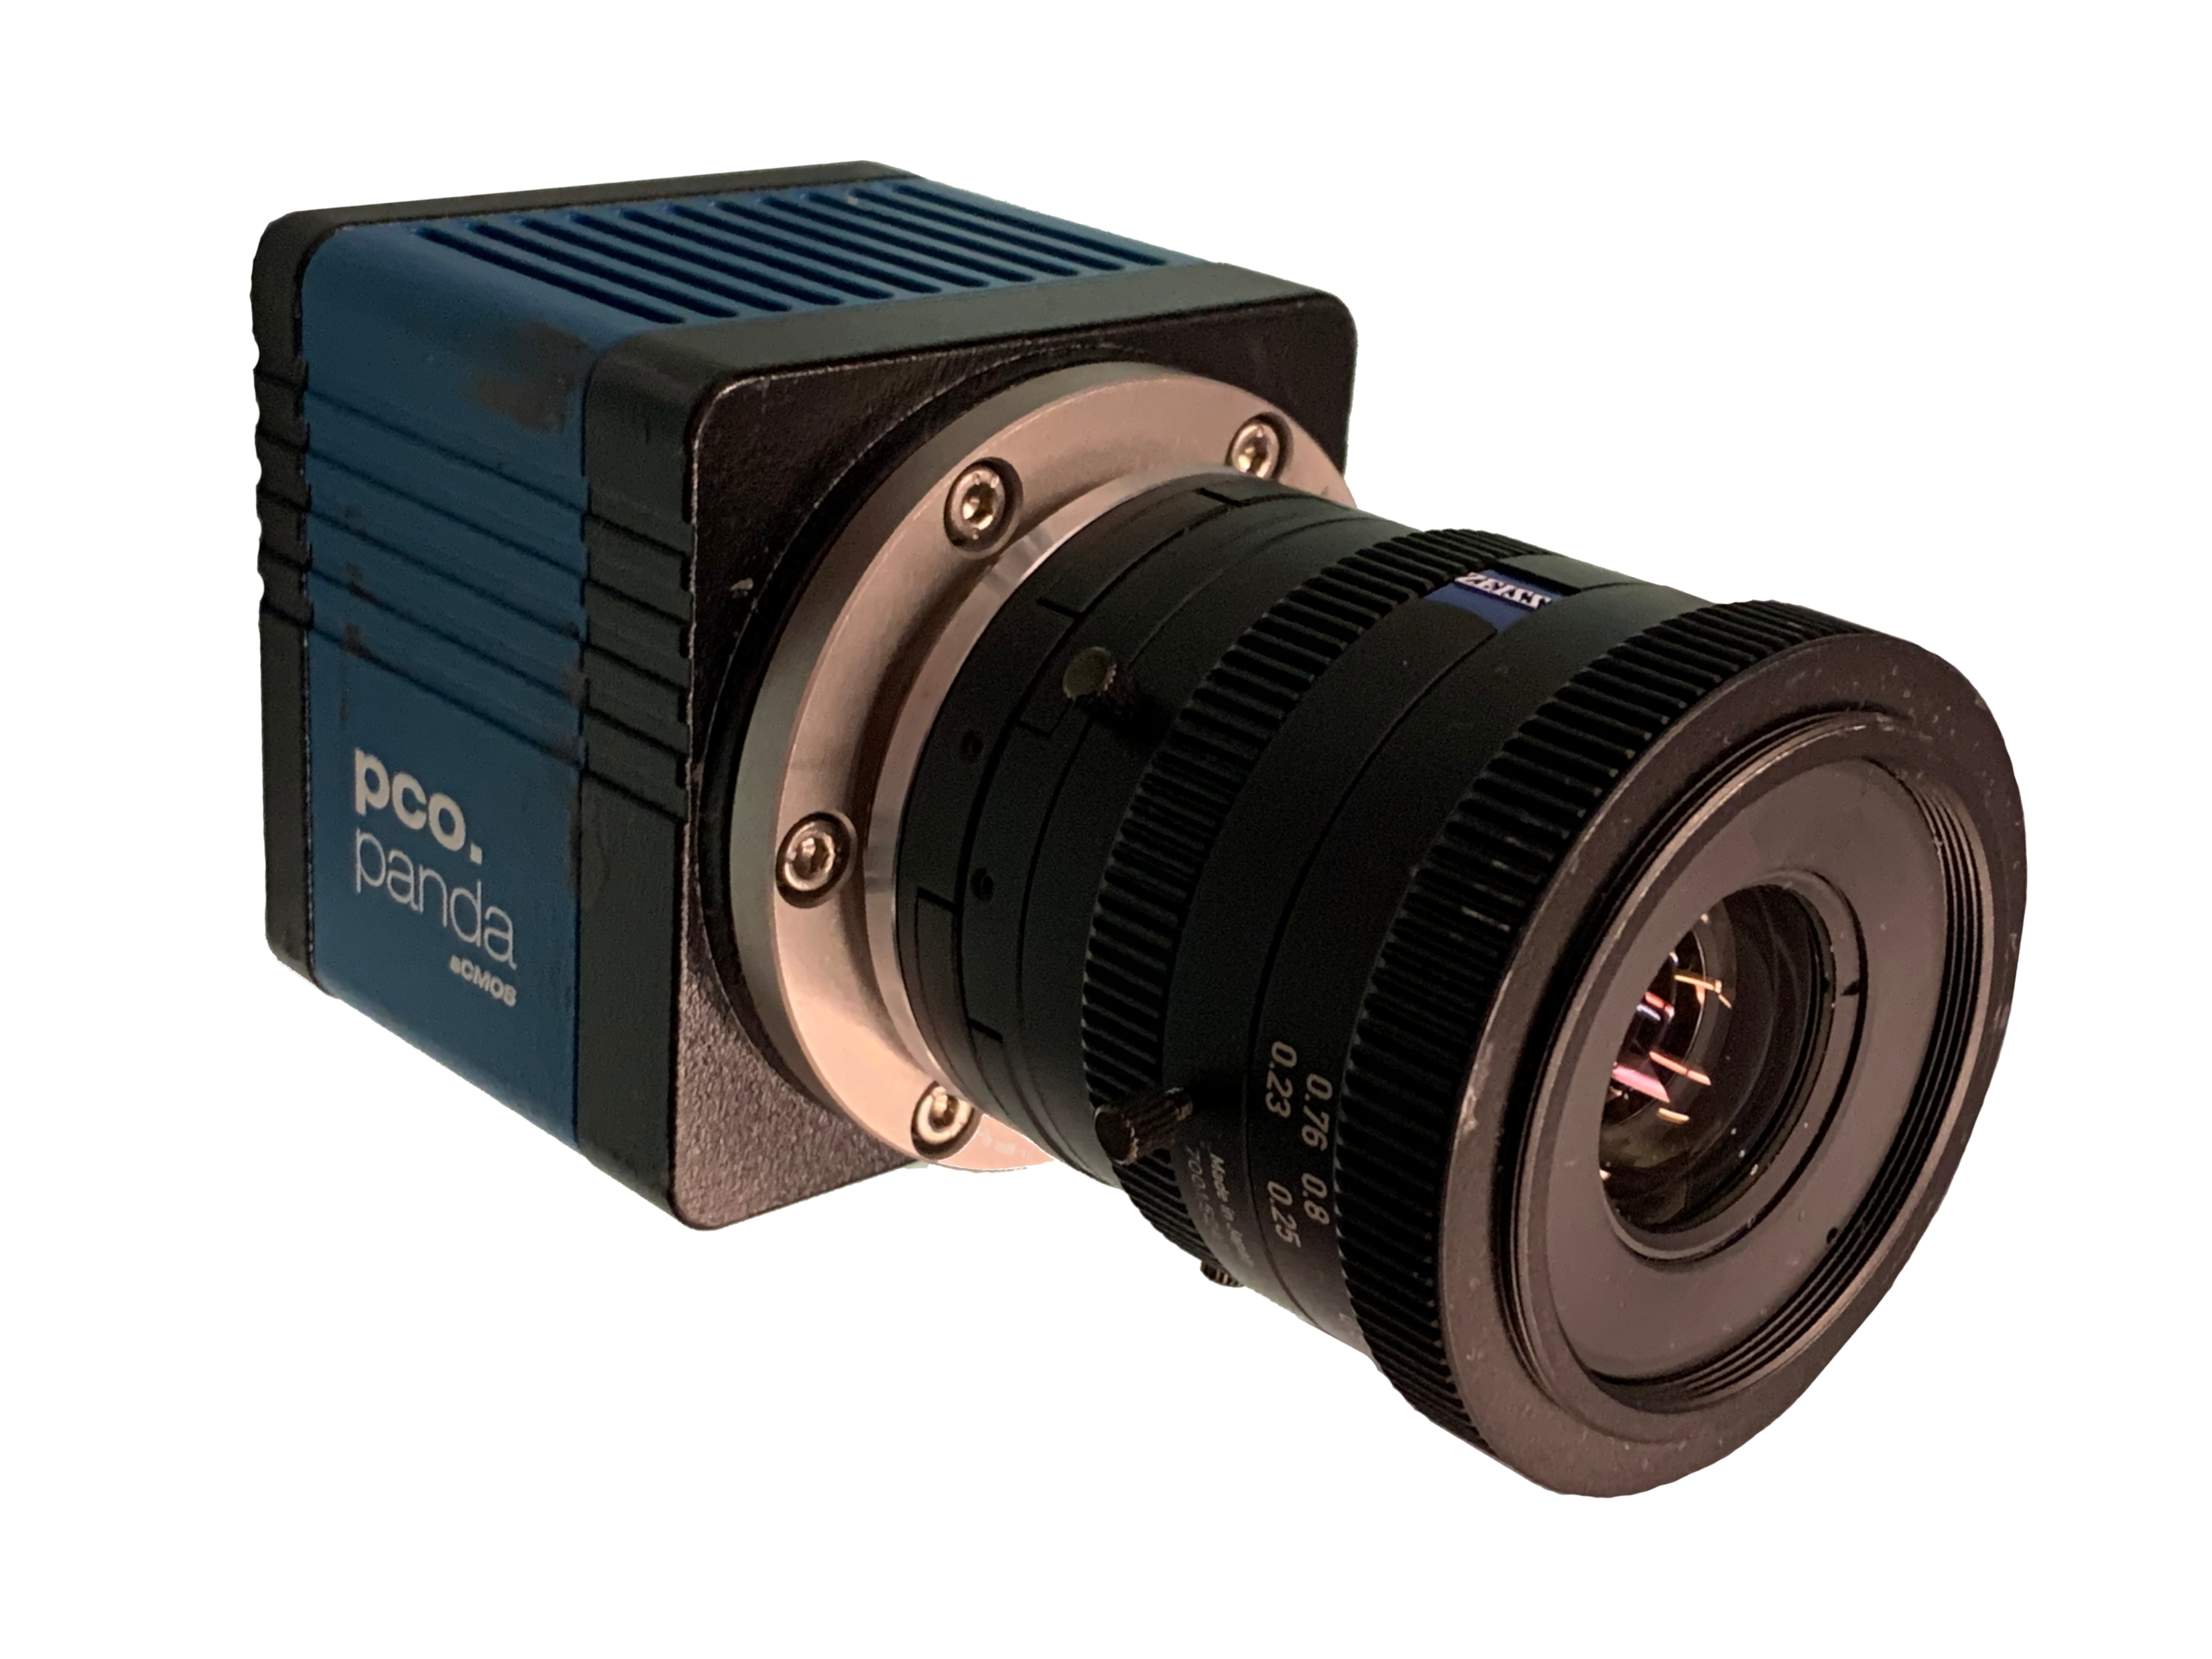
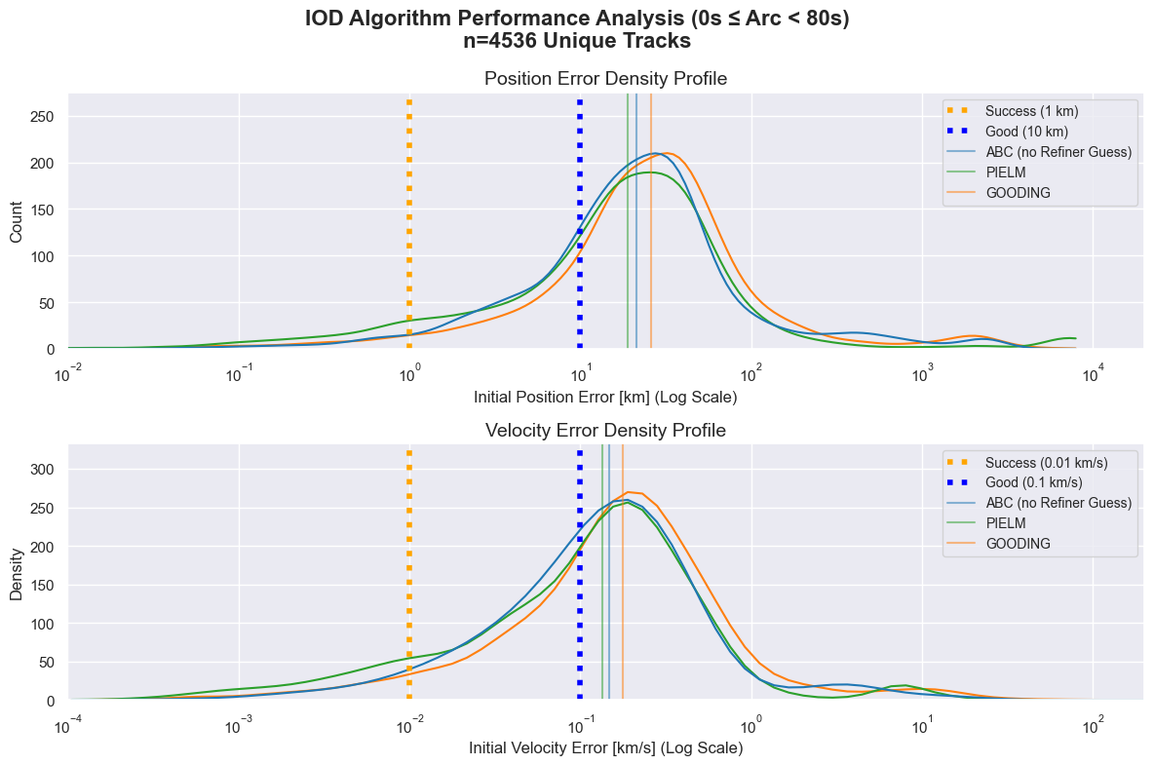
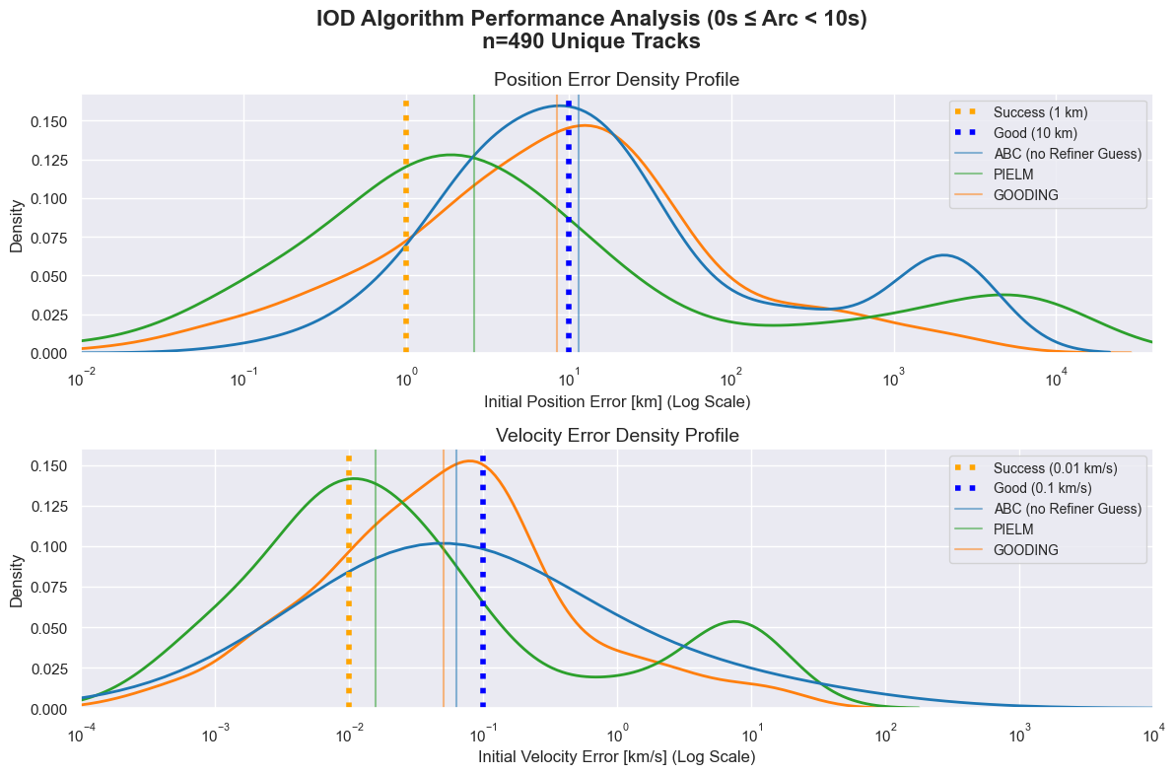
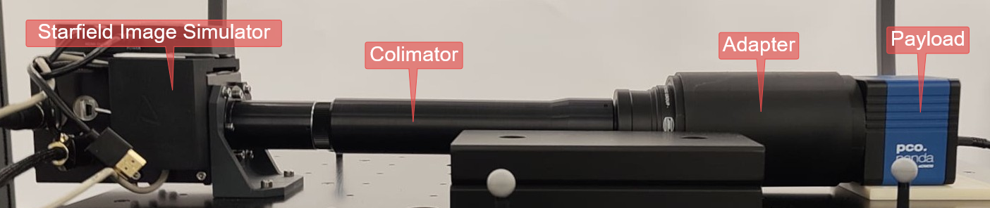
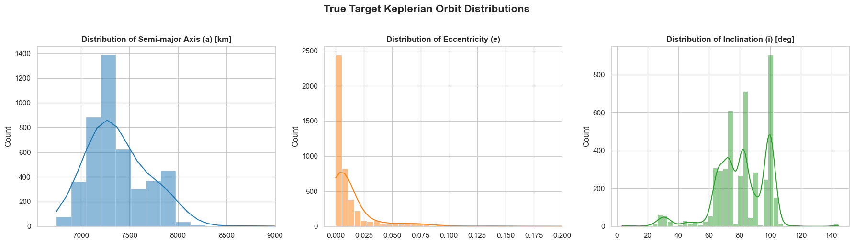



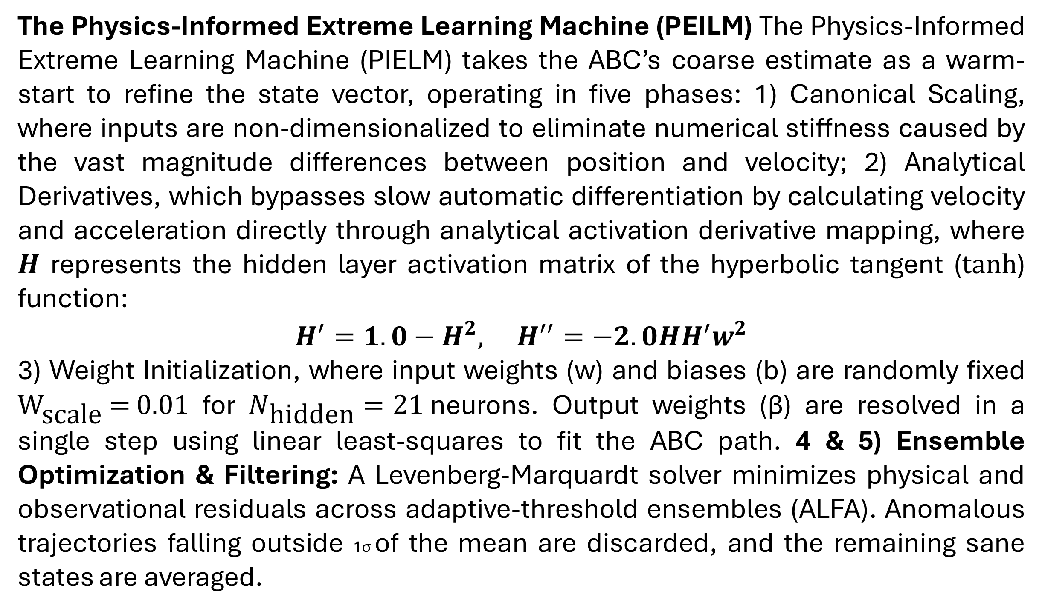
Hardware-in-the-Loop Validation of Physics-Informed Neural Network for Angles-Only Initial Orbit Determination in Very Short Arcs.
Ian Porto*, Marissa Myhre, Sofia Mesón-Pérez, Angel Porras-Hermoso, Gunho Sohn, Regina S.K. Lee*
1. INTRODUCTION AND MOTIVATION
3. HARDWARE-IN-THE-LOOP
5. KEY RESULTS
Motivation: The rapid proliferation of mega-constellations is driving an exponential increase in Resident Space Objects (RSOs) in Low Earth Orbit (LEO). To mitigate collision risks and prevent Kessler Syndrome, highly scalable and cost-effective sensor networks are required.
Star trackers offer a scalable, space-based solution for RSO tracking.
The second step of this process uses an Airbus Star Tracker Optical Simulator (STOS) to physically light up the sensor with point sources for stars, and for RSOs. By projecting these synthetic point sources directly into the optical chain of the payload, we capture flight-representative, non-Gaussian noise and realistic sensor degradation modes that are difficult to purely simulate in software. The true inertial states from STK serve as the absolute ground truth, synchronized with the hardware-in-the-loop to ensure accurate benchmarking.
Preliminary Analysis of the very short arcs under 80 seconds, show that all three methods perform about equivalently, with the PINN performing slightly better than the classical (Gooding’s) baseline as seen in figures 6. However, looking figure 7 with the arcs under 10 seconds, the regime the network was designed for, shows that the PINN methodology experiences an ~4 times increase in successes as shown in table 1.
The Payload (shown in figure 1) under test is an Excelitas PCO Panda 4.2, which has been used as a dual-use star tracker in three stratospheric balloon flights. The payload will fly onboard Universidad Politécnica de Madrid’s UPMSat-4. It will capture images for ten minutes per orbit.
Figure 3: a 60 second stacked image sequence from the starfield simulator.
Figure 1: The Payload Flown on RSONAR 1,2 and 3
The Very Short Arc (VSA) Problem arises due to the high relative velocities of objects in LEO, the natural observation window for a star tracker is compressed into a very short arc, typically these are observations under 80 seconds, depending on geometry. During these extremely brief intervals, the orbital curvature of the RSO is practically unobservable and classical methods tend to fail, diverge or return realistic, but incorrect Ghost orbits.
Figure 6: Error Distribution of the Three methods for track durations under 80 sec
Figure 7: Error Distribution of the Three methods in the very short arc with track durations under 10 sec
Figure 4: The Hardware-In-The-Loop setup of the starfield simulator and the payload.
Error Metrics | Classical | ABC | PIELM
Success < 1 km (<10s) | 15.98 % | 7.30 % | 53.11 %
Acceptance < 10 km (<10s) | 47.73 % | 44.77 % | 76.35 %
Table 1: Error Metrics for the 490 tracks under 10 seconds
Physics-Informed Neural Networks (PINNs) bypass both the steep computational costs and the brittle iterative instabilities characteristic of conventional numerical differential equation solvers. This makes them very well suited to IOD and the VSA Problem
This work presents a PINN approach evaluated on realistic hardware-in-the-loop simulated images to solve the VSA problem.
4. ARCHITECTURE METHODOLOGIES
The Physics-Informed Neural Network (PINN) is split into two distinct sections, all beginning from the measured RA and DEC which are outputted either by the Resident Space Object detection and tracking code, or for preliminary results, simply pulled from the truth information inputted into the Starfield Simulator.
A metaheuristic solver is first used to estimate the coarse orbit, in this work we use an Artificial Bee Colony (ABC), which estimates the orbit in three phases.
In the highly constrained < 10-second tracking window, the Physics-Informed Extreme Learning Machine (PIELM) significantly outperforms classical baselines:
~4x Boost in Sub-1 km Accuracy: (53.11% vs. 15.98%)
+31% Boost in Sub-10 km Acceptance: (76.35% vs. 47.73%)
2. SIMULATED DATA
The Observer’s Orbit has been selected based on the UPMSat-4 mission’s profile. As such two candidate Sun Synchronous Orbits (SSO) were defined, both with the same Anti-Ram pointing for the sensor. The first candidate orbit is a 10:30am SSO at 550 km, the second candidate orbit is a 12:30pm SSO at 550 km.
The Targets were simulated using ANSYS System Tool Kit (STK). We computed the access of satellites within the sensor’s Field of View using their Two Line Elements (TLE) to output their Right Ascension (RA) and Declination (DEC) and their true State (ECI Position and Velocity) to be used as the truth values.
6. CONCLUSION
Overcoming VSA Limitations: Classical Initial Orbit Determination (IOD) solvers suffer severe performance degradation during extreme Very Short Arcs. Our results demonstrate that the PIELM architecture successfully bypasses these iterative instabilities, achieving a ~4x increase in highly accurate orbit estimations (under 1 km of error) for tracks under 10 seconds.
Short-Term Future Work: The performance evaluation will be rerun using input values extracted directly from the processed Hardware-in-the-Loop images, rather than relying on the initially inputted truth data.
Long-Term Future Work: Moving forward, this hardware-in-the-loop dataset will be leveraged to investigate alternative AI-based IOD methodologies. This will include evaluating different metaheuristic optimization models to replace the current Artificial Bee Colony (ABC) framework, as well as exploring deep learning architectures to further enhance orbit estimation capabilities in the VSA regime.
Figure 5: Algorithm Architecture flowchart
The Physics-Informed Extreme Learning Machine (PEILM) The Physics-Informed Extreme Learning Machine (PIELM) takes the ABC’s coarse estimate as a warm-start to refine the state vector, operating in five phases: 1) Canonical Scaling, where inputs are non-dimensionalized to eliminate numerical stiffness caused by the vast magnitude differences between position and velocity; 2) Analytical Derivatives, which bypasses slow automatic differentiation by calculating velocity and acceleration directly through analytical activation derivative mapping, where $H$ represents the hidden layer activation matrix of the hyperbolic tangent ($tanh$) function:
$$H^{′}=1.0−H^{2}, H^{′′}=−2.0HH^{′}w^{2}$$
3) Weight Initialization, where input weights (w) and biases (b) are randomly fixed ${\text{W}}_{\text{scale}}\text{ = 0.01}$ for $N_{\text{hidden}}=21$neurons. Output weights (β) are resolved in a single step using linear least-squares to fit the ABC path. 4 & 5) Ensemble Optimization & Filtering: A Levenberg-Marquardt solver minimizes physical and observational residuals across adaptive-threshold ensembles (ALFA). Anomalous trajectories falling outside 1σ of the mean are discarded, and the remaining sane states are averaged.
Figure 2: Simulated TLE Orbital Parameter Distribution.
Solving the VSA problem is a critical step toward enabling scalable, autonomous space-based tracking networks, directly answering the need for cost-effective collision mitigation in an increasingly congested Low Earth Orbit.
Sources& MORE
Figure 2, shows the distribution of the simulated TLEs orbital parameters. We can see that the semi-major axis and the eccentricity, are as expected, distributed normally, while the inclination has a more uniform distribution, with a few outliers. This will drive our metaheuristic solver’s penalties for incorrect orbits.
INFO
* Corresponding Authors: Ianporto@yorku.ca, reginal@yorku.ca
York University, Toronto, Ontario, Canada

